Slide 1
Classification
Decision Tree Induction
Best Split
Measures of Node Impurity

Slide 2
DECISION TREE [Quinlan93]
An internal node represents a test on an attribute.
A branch represents an outcome of the test, e.g., Color=red.
A leaf node represents a class label or class label distribution.
At each node, one attribute is chosen to split training examples into distinct classes as much as possible
A new case is classified by following a matching path to a leaf node.

Slide 3
Training Set

Slide 4
Example
Outlook
sunny
overcast
rain
overcast
humidity
P
windy
high
normal
true
false
N
P
N
P

Slide 5
Building Decision Tree [Q93]
Top-down tree construction
At start, all training examples are at the root.
Partition the examples recursively by choosing one attribute each time.
Bottom-up tree pruning
Remove subtrees or branches, in a bottom-up manner, to improve the estimated accuracy on new cases.

Slide 6
Choosing the Splitting Attribute
At each node, available attributes are evaluated on the basis of separating the classes of the training examples. A Goodness function is used for this purpose.
Typical goodness functions:
information gain (ID3/C4.5)
information gain ratio
gini index

Slide 7
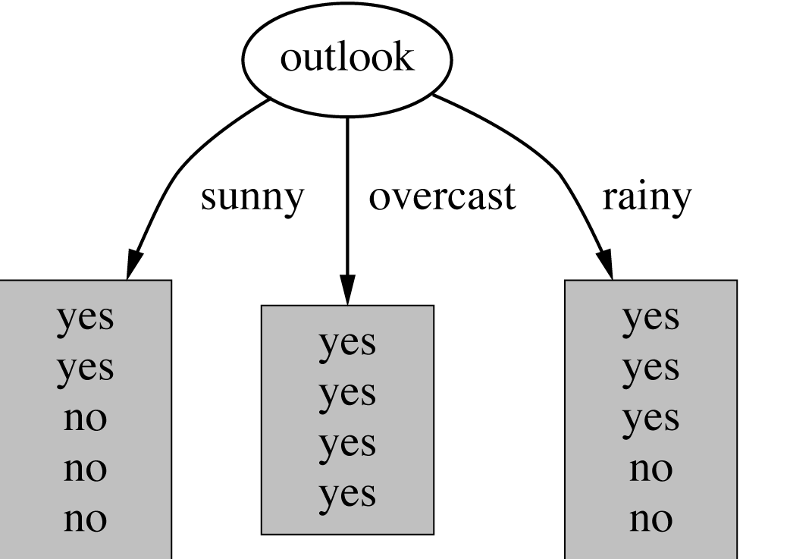
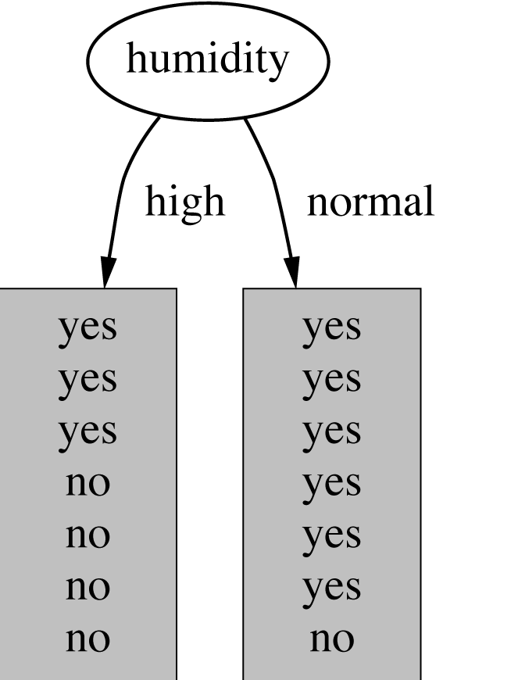
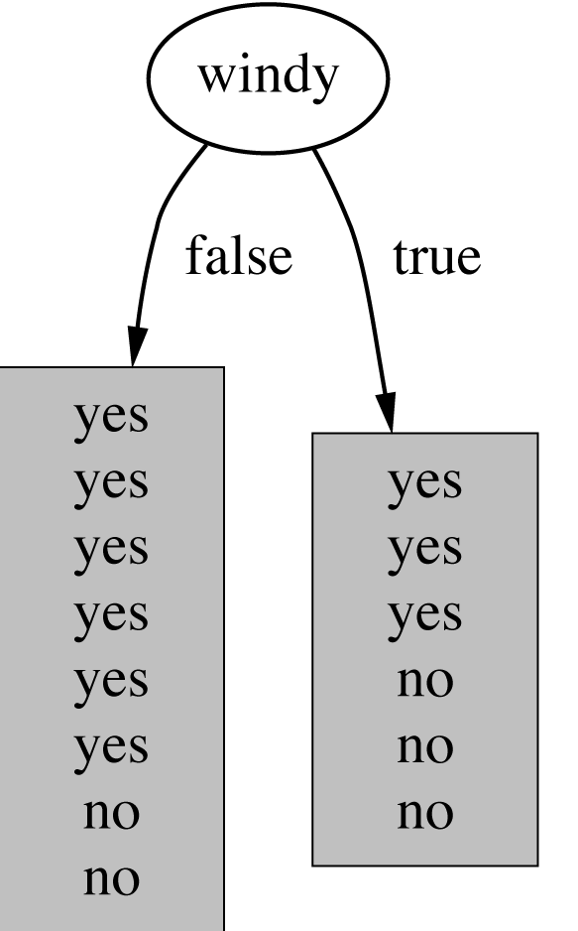
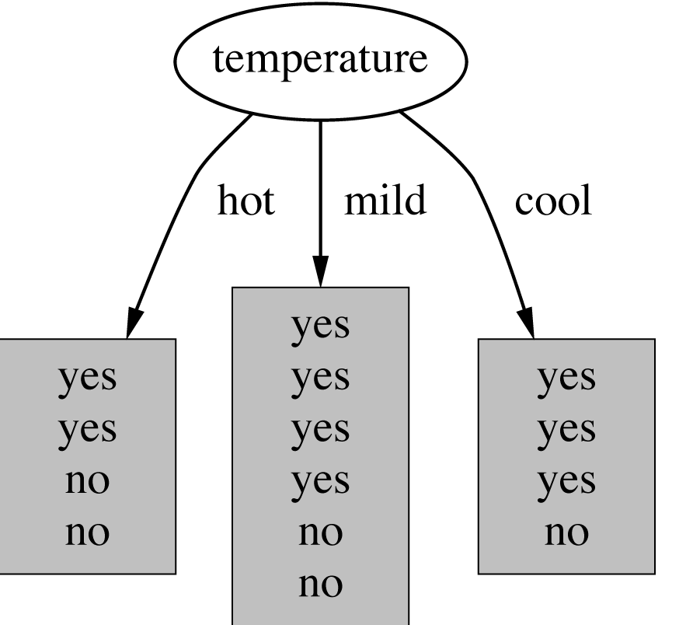
Which attribute to select?

Slide 8
A criterion for attribute selection
Which is the best attribute?
The one which will result in the smallest tree
Heuristic: choose the attribute that produces the “purest” nodes
Popular impurity criterion: information gain
Information gain increases with the average purity of the subsets that an attribute produces
Strategy: choose attribute that results in greatest information gain

Slide 9
Computing information
Information is measured in bits
Given a probability distribution, the info required to predict an event is the distribution’s entropy
Entropy gives the information required in bits (this can involve fractions of bits!)
Formula for computing the entropy:

Slide 10
Example: attribute “Outlook”
“Outlook” = “Sunny”:
“Outlook” = “Overcast”:
“Outlook” = “Rainy”:
Expected information for attribute:
Note: this is
normally not
defined.

Slide 11
Computing the information gain
Information gain: information before splitting – information after splitting
Information gain for attributes from weather data:

Slide 12
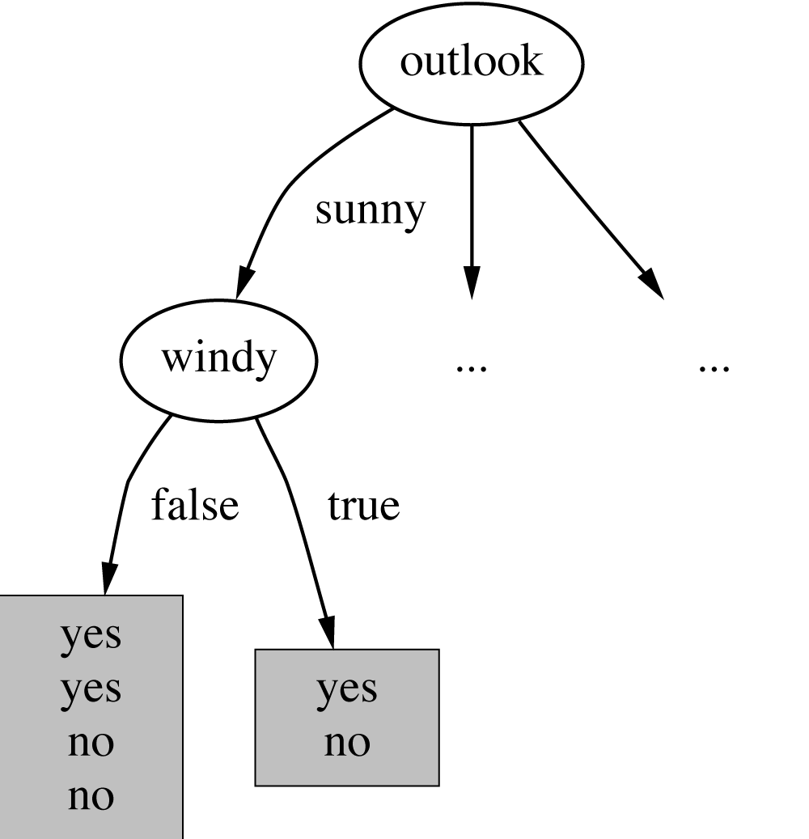
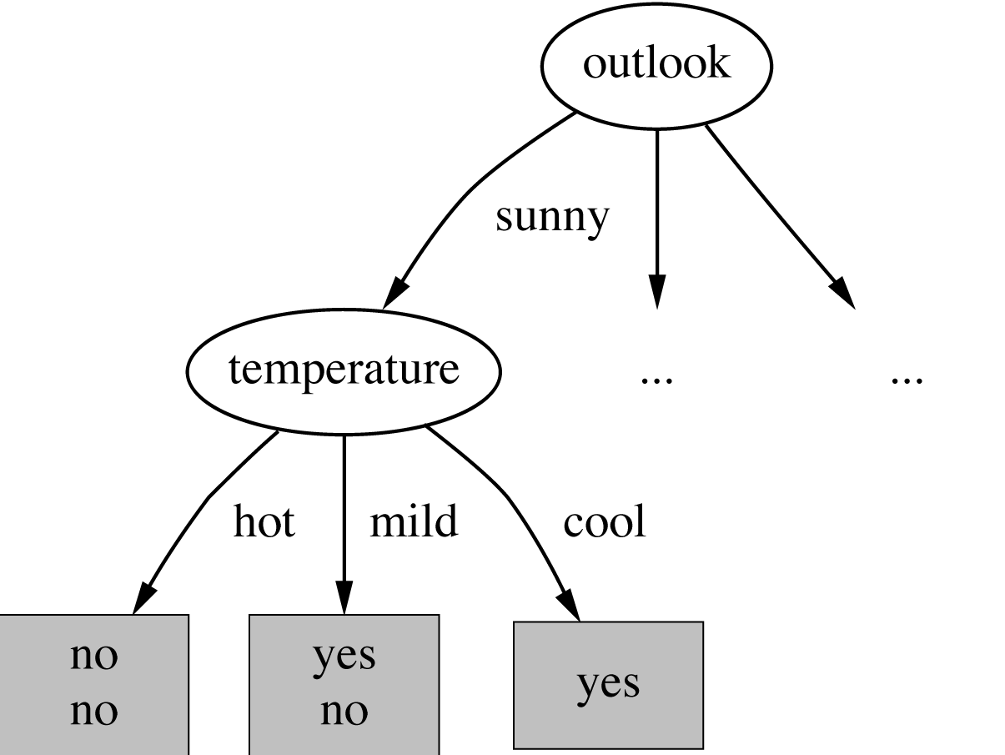
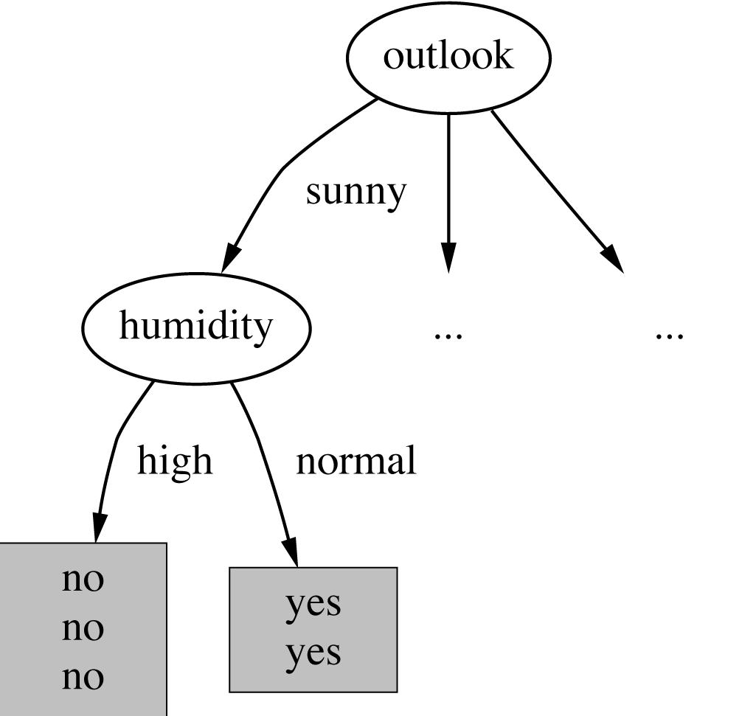
Continuing to split

Slide 13
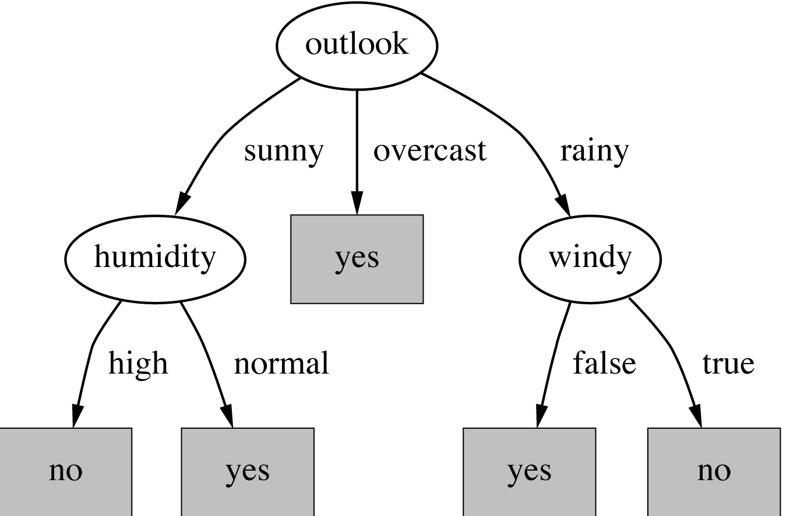
The final decision tree
Note: not all leaves need to be pure; sometimes identical instances have different classes
⇒ Splitting stops when data can’t be split any further

Slide 14
Gain
Gain of an attribute split: compare the impurity of the parent node with the average impurity of the child nodes
Maximizing the gain ⇔ Minimizing the weighted average impurity measure of children nodes
If I() = Entropy(), then Δ_{info} is called information gain

Slide 15
Splitting Based on GINI
Used in CART, SLIQ, SPRINT.
When a node p is split into k partitions (children), the quality of split is computed as,
where, n_{i} = number of records at child i,
n = number of records at node p.
Weighted Average of Gini Index

Slide 16
Binary Attributes: Computing GINI Index
Splits into two partitions
Effect of Weighing partitions:
Larger and Purer Partitions are sought for.
B?
Yes
No
Node N1
Node N2
Gini(N1) = 1 – (5/7)² – (2/7)² = 0.41
Gini(N2) = 1 – (1/5)² – (4/5)² = 0.32
Gini(Children) = 7/12 * 0.41 + 5/12 * 0.32 = 0.37

Slide 17
Categorical Attributes: Computing Gini Index
For each distinct value, gather counts for each class in the dataset
Use the count matrix to make decisions
Multi-way split
Two-way split
(find best partition of values)

Slide 18
Continuous Attributes: Computing Gini Index
Use Binary Decisions based on one value
Several Choices for the splitting value
Number of possible splitting values = Number of distinct values
Each splitting value has a count matrix associated with it
Class counts in each of the partitions, A < v and A ≥ v
Simple method to choose best v
For each v, scan the database to gather count matrix and compute its Gini index
Computationally Inefficient! Repetition of work.

Slide 19
Continuous Attributes: Computing Gini Index..
For efficient computation: for each attribute,
Sort the attribute on values
Linearly scan these values, each time updating the count matrix and computing gini index
Choose the split position that has the least gini index
Sorted Values
Split Positions

Slide 20
Highly-branching attributes
Problematic: attributes with a large number of values (extreme case: ID code)
Subsets are more likely to be pure if there is a large number of values
Information gain is biased towards choosing attributes with a large number of values
This may result in overfitting (selection of an attribute that is non-optimal for prediction)
Another problem: fragmentation

Slide 21
The gain ratio
Gain ratio: a modification of the information gain that reduces its bias on high-branch attributes
Gain ratio takes number and size of branches into account when choosing an attribute
It corrects the information gain by taking the intrinsic information of a split into account
Also called split ratio
Intrinsic information: entropy of distribution of instances into branches
(i.e. how much info do we need to tell which branch an instance belongs to)

Slide 22
Gain Ratio
Gain ratio should be
Large when data is evenly spread
Small when all data belong to one branch
Gain ratio (Quinlan’86) normalizes info gain by this reduction:

Slide 23
Computing the gain ratio
Example: intrinsic information for ID code
Importance of attribute decreases as intrinsic information gets larger
Example of gain ratio:
Example:

Slide 24
Gain ratios for weather data
Outlook |  | Temperature
Info: | 0.693 | Info: | 0.911
Gain: 0.940-0.693 | 0.247 | Gain: 0.940-0.911 | 0.029
Split info: info([5,4,5]) | 1.577 | Split info: info([4,6,4]) | 1.362
Gain ratio: 0.247/1.577 | 0.156 | Gain ratio: 0.029/1.362 | 0.021
Humidity |  | Windy
Info: | 0.788 | Info: | 0.892
Gain: 0.940-0.788 | 0.152 | Gain: 0.940-0.892 | 0.048
Split info: info([7,7]) | 1.000 | Split info: info([8,6]) | 0.985
Gain ratio: 0.152/1 | 0.152 | Gain ratio: 0.048/0.985 | 0.049

Slide 25
More on the gain ratio
“Outlook” still comes out top
However: “ID code” has greater gain ratio
Standard fix: ad hoc test to prevent splitting on that type of attribute
Problem with gain ratio: it may overcompensate
May choose an attribute just because its intrinsic information is very low
Standard fix:
First, only consider attributes with greater than average information gain
Then, compare them on gain ratio

Slide 26
Decision Tree Induction: Training Dataset

Slide 27
Output: A Decision Tree for “buys_computer”
age?
<=30
overcast
>40
31..40
student?
yes
credit rating?
no
yes
excellent
fair
no
yes
no
yes

Slide 28
Attribute Selection: Information Gain
Class P: buys_computer = “yes”
Class N: buys_computer = “no”
means “age <=30” has 5 out of 14 samples, with 2 yes’es and 3 no’s. Hence
Similarly,

Slide 29
Splitting Based on INFO...
Information Gain:
Parent Node, p is split into k partitions;
n_{i} is number of records in partition i
Measures Reduction in Entropy achieved because of the split. Choose the split that achieves most reduction (maximizes GAIN)
Used in ID3 and C4.5
Disadvantage: Tends to prefer splits that result in large number of partitions, each being small but pure.

Slide 30
Splitting Based on INFO...
Gain Ratio:
Parent Node, p is split into k partitions
n_{i} is the number of records in partition i
Adjusts Information Gain by the entropy of the partitioning (SplitINFO). Higher entropy partitioning (large number of small partitions) is penalized!
Used in C4.5
Designed to overcome the disadvantage of Information Gain

Slide 31
Tree Induction
Greedy strategy.
Split the records based on an attribute test that optimizes certain criterion.
Issues
Determine how to split the records
How to specify the attribute test condition?
How to determine the best split?
Determine when to stop splitting

Slide 32
Stopping Criteria for Tree Induction
Stop expanding a node when all the records belong to the same class
Stop expanding a node when all the records have similar attribute values
Early termination (to be discussed later)

Slide 33
Decision Tree Based Classification
Advantages:
Inexpensive to construct. It does not require any domain knowledge.
Extremely fast at classifying unknown records
convertible to simple and easy to understand classification rules
Easy to interpret for small-sized trees
Accuracy is comparable to other classification techniques for many simple data sets

Slide 34
Example: C4.5
Simple depth-first construction.
Uses Information Gain
Sorts Continuous Attributes at each node.
Needs entire data to fit in memory.
Unsuitable for Large Datasets.
Needs out-of-core sorting.

Slide 35
Practical Issues of Classification
Underfitting and Overfitting
Missing Values
Costs of Classification

Slide 36
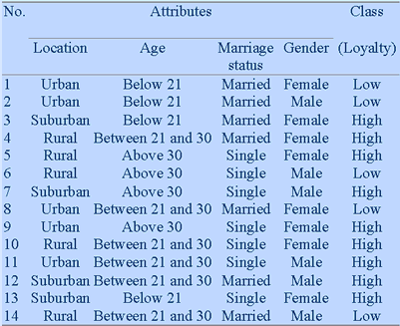
Another Example

Slide 37
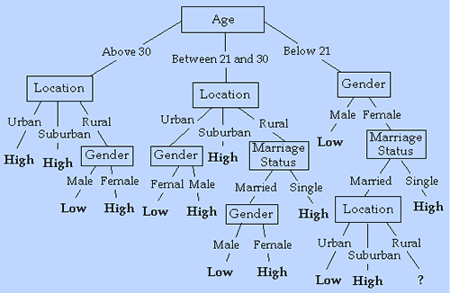
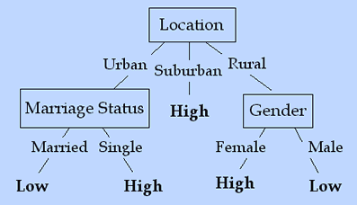
Another Example

Slide 38
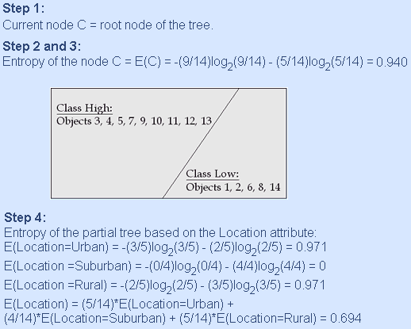
Decision Tree Generation Algorithm: ID3

Slide 39
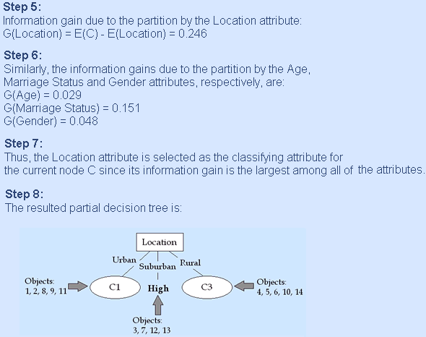
Decision Tree Generation Algorithm: ID3

Slide 40
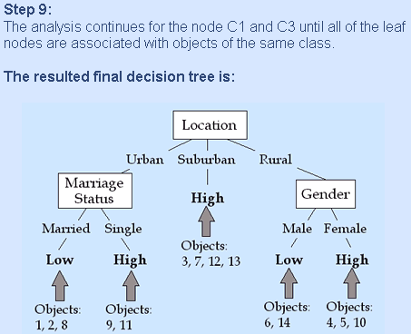
Decision Tree Generation Algorithm: ID3

Slide 41
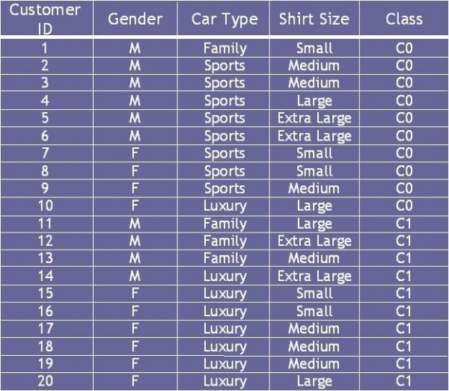
Table 4.7 Data Set
Consider the training examples shown in Table 4.7 for a binary classification problem.
(a) Compute the Gini index for the overall collection of training examples.
(b) Compute the Gini index for the Customer ID attribute.
(c) Compute the Gini index for the Gender attribute.
(d) Compute the Gini index for the Car Type attribute using multiway split.
(e) Compute the Gini index for the Shirt Size attribute using multiway split.
(f) Which attribute is better, Gender, Car Type, or Shirt Size?

Slide 42
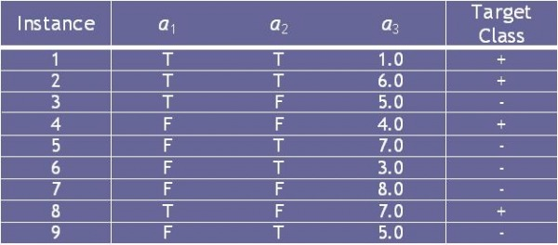
Consider the training examples shown in Table 4.8 for a binary classification problem.
Table 4.8 Data Set
(a) What is the entropy of this collection of training examples with respect to the positive class?
(b) What are the information gains of a1 and a2 relative to these training examples?
(c) For a3, which is a continuous attribute, compute the information gain for every possible split.
(d) What is the best split (between a1, a2, and a3) according to the information gain?
(e) What is the best split (between a1, and a2) according to the classification error rate?
(f) What is the best split (between a1 and a2) according to the Gini index?

Slide 43
Characteristics of Decision Tree Induction
Non Parametric approach
Finding an optimal decision tree is an NP-Complete Problem.
Uses Computationally inexpensive techniques
Robust of handle the presence of Noise
Presence of Redundant Attributes (No Effect)
Presence of Irrelevant Attributes(Overfitting)
Data Fragmentation
Subtree Replication
Decision Boundary
Oblique Decision Tree
Constructive Induction

Slide 44
Other Issues
Data Fragmentation
Search Strategy
Expressiveness
Tree Replication

Slide 45
Data Fragmentation
Number of instances gets smaller as you traverse down the tree
Number of instances at the leaf nodes could be too small to make any statistically significant decision
You can introduce a lower bound on the number of records per leaf node in the stopping criterion.

Slide 46
Tree Replication
Same subtree appears in multiple branches

Slide 47
Search Strategy
Finding an optimal decision tree is NP-hard
The algorithm presented so far uses a greedy, top-down, recursive partitioning strategy to induce a reasonable solution
Other strategies?
Bottom-up
Bi-directional

Slide 48
Expressiveness
A classifier defines a function that discriminates between two (or more) classes.
The expressiveness of a classifier is the class of functions that it can model, and the kind of data that it can separate
When we have discrete (or binary) values, we are interested in the class of boolean functions that can be modeled
If the data-points are real vectors we talk about the decision boundary that the classifier can model

Slide 49
Expressiveness
Decision tree provides expressive representation for learning discrete-valued function
But they do not generalize well to certain types of Boolean functions
Example: parity function:
Class = 1 if there is an even number of Boolean attributes with truth value = True
Class = 0 if there is an odd number of Boolean attributes with truth value = True
For accurate modeling, must have a complete tree
Not expressive enough for modeling continuous variables
Particularly when test condition involves only a single attribute at-a-time

Slide 50
Decision Boundary
Border line between two neighboring regions of different classes is known as decision boundary
Decision boundary is parallel to axes because test condition involves a single attribute at-a-time

Slide 51
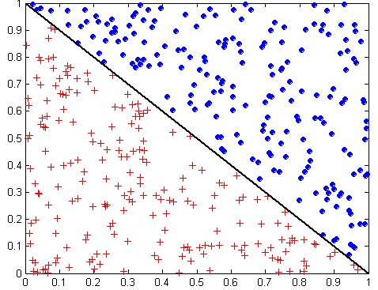
Oblique Decision Trees
x + y < 1
Class = +
Class =
Test condition may involve multiple attributes
More expressive representation
Finding optimal test condition is computationally expensive

